Slide 1
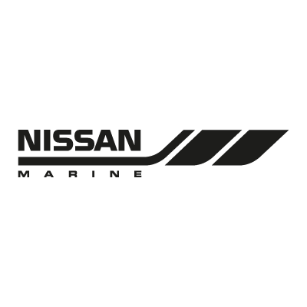
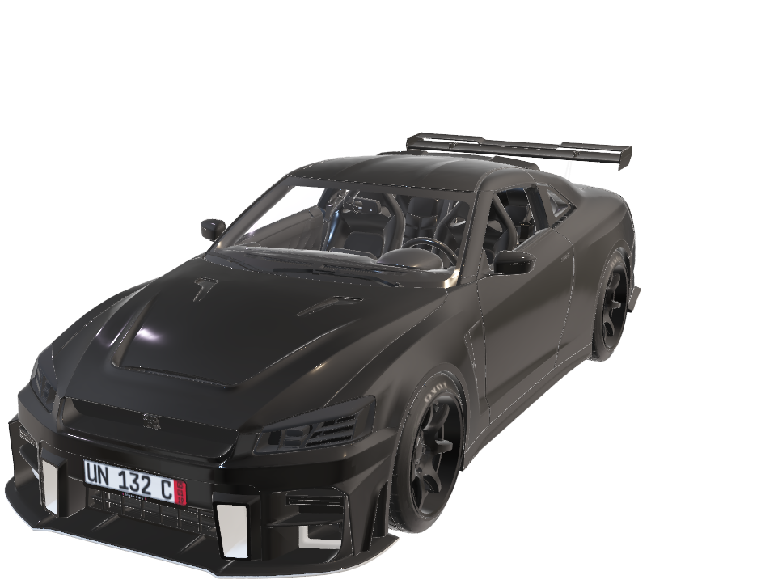

Slide 2
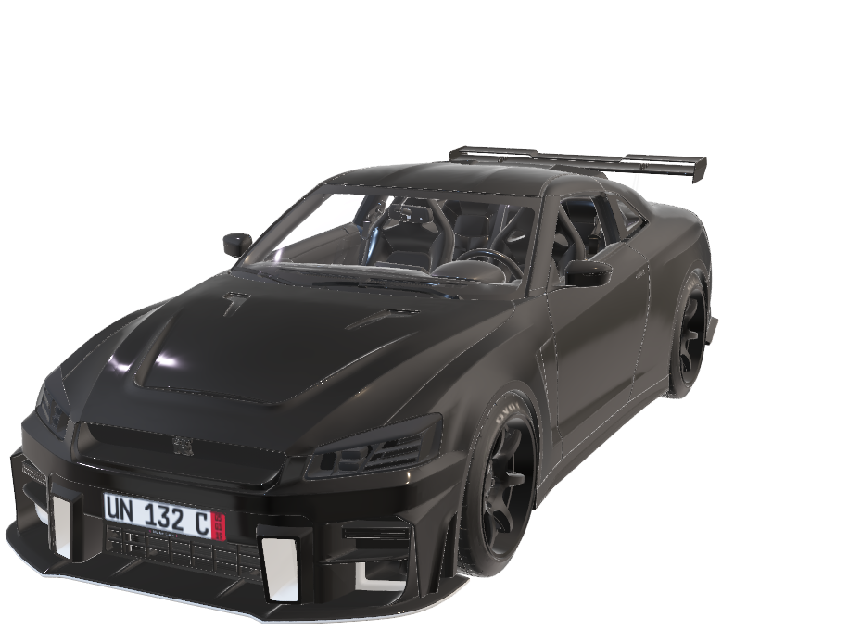
NISSAN GT-R
Founded in 1933: Nissan Motor Co., Ltd. is a Japanese automobile manufacturer founded in Yokohama, Japan. It was originally named "Jidosha-Seizo Co., Ltd." before becoming Nissan in 1934.
Global Presence: Nissan is one of the largest car manufacturers in the world, with a significant market share in regions like Japan, North America, and Europe. It sells vehicles under the Nissan, Infiniti, and Datsun brands.

Slide 3
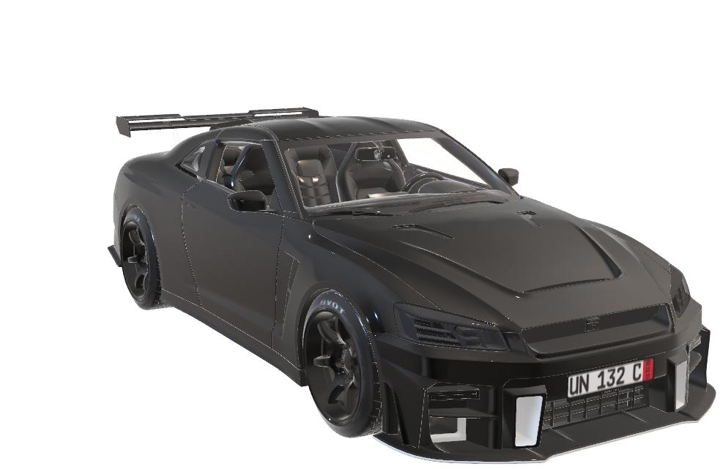
TOP SPEED
196 MILE/HR

Slide 4
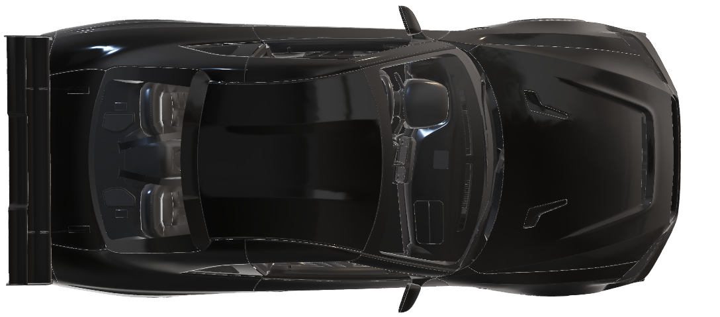
FEATURES
Advanced all-wheel steering (HICAS)
Electronic traction control (TCS)
Anti-lock braking system (ABS)
Sport-tuned suspension
16-inch alloy wheels

Slide 5
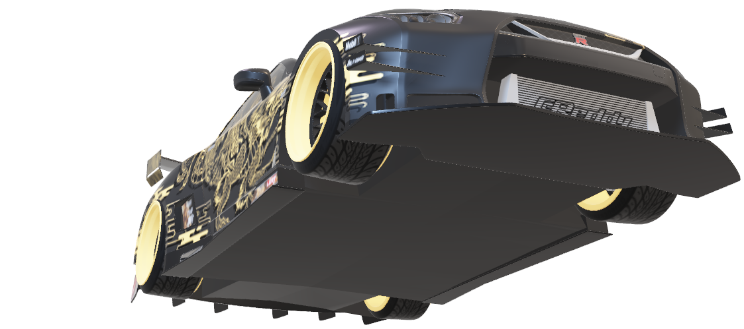
Le Mans(France)
Chanpions

Slide 6
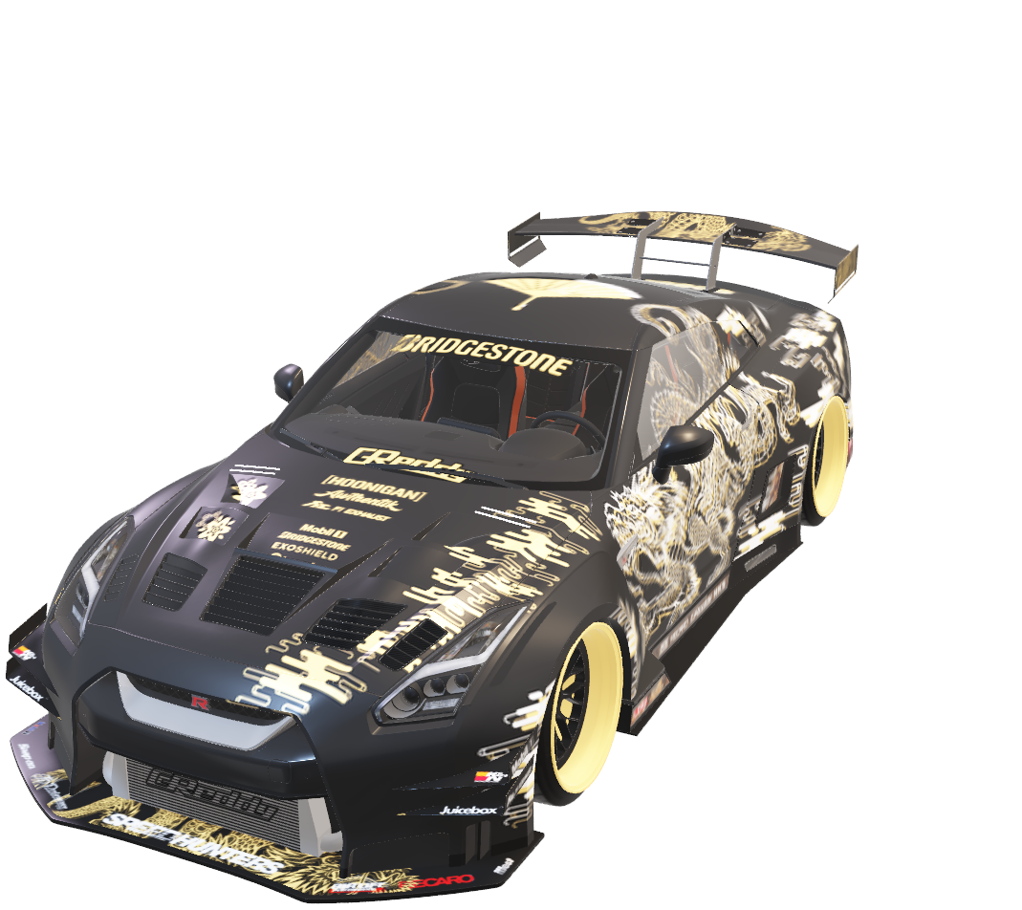
Rs. 2.12 Crore

Slide 7
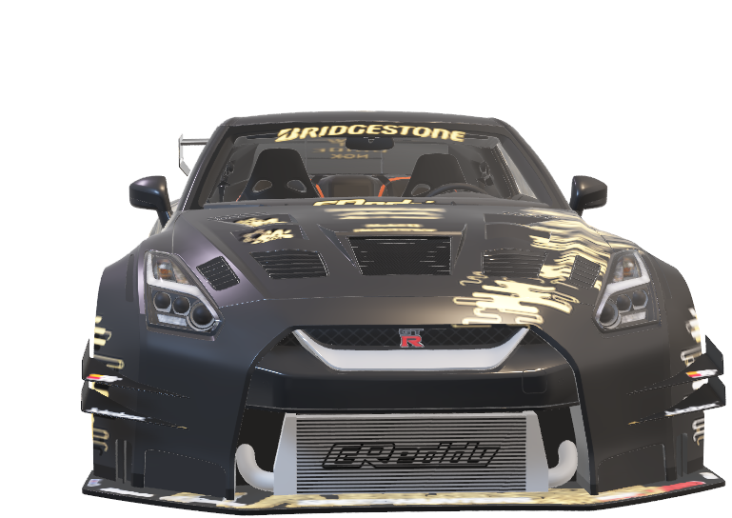

Slide 8
QUIZ

Slide 9
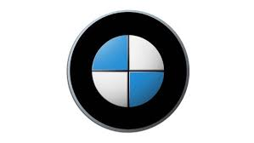

Slide 10
BMW

Slide 11


Slide 12
volkswagen

Slide 13
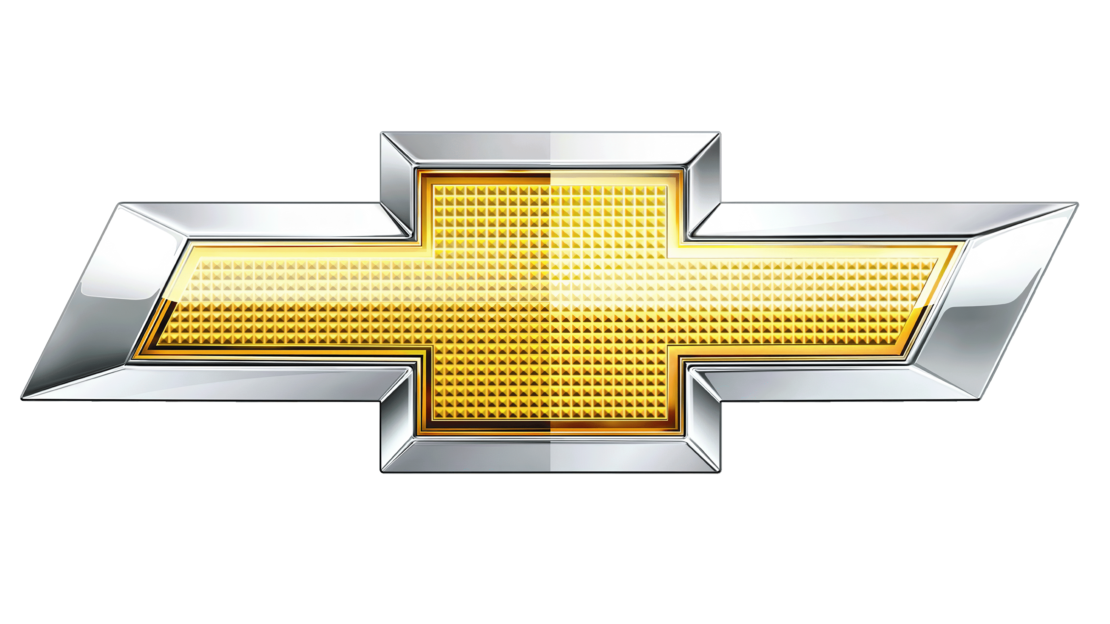

Slide 14
chevy

Slide 15


Slide 16
shubaru

Slide 17


Slide 18
lamborghini

Slide 19
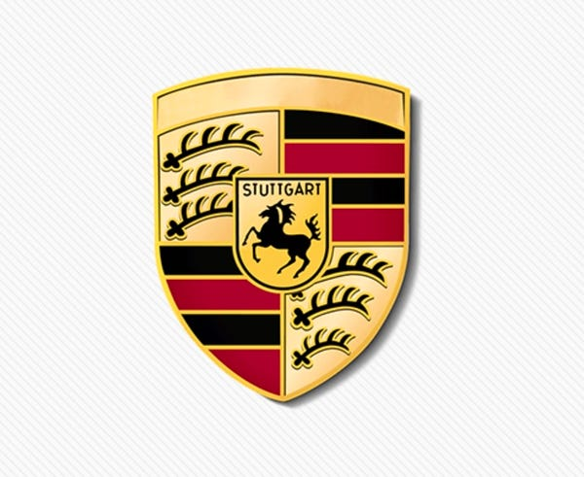

Slide 20
porsche

Slide 21


Slide 22
bentley

Slide 23
QUIZ END

Slide 24
EVOLUTION

Slide 25
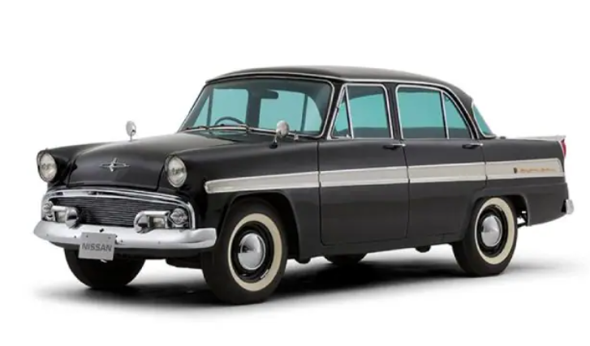
First Skyliner
Debut: 1957
2. Compact sedan
3. 1.5L engine (60 horsepower)
4. Rear-wheel drive
American-inspired design

Slide 26
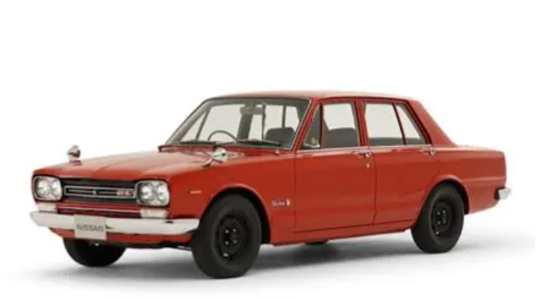
1st Gen
Engine: 1.5L ALSI-1 inline-4 (60 HP)
Transmission: 4-speed manual
Drive: Rear-wheel drive
Length/Width/Height: 4,620/1,670/1,450 mm
Wheelbase: 2,400 mm
Weight: 960 kg
Top Speed: 145 km/h
Fuel Efficiency: 10 km/L

Slide 27
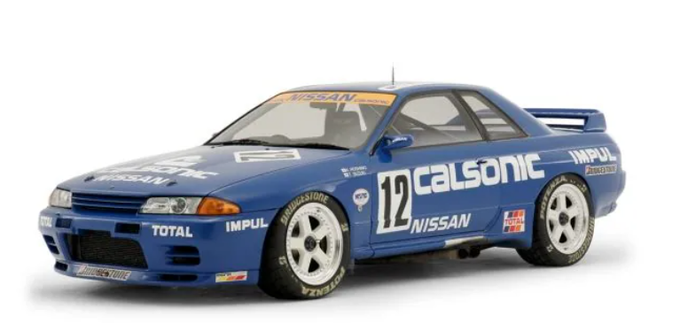
R32
0-100 km/h: 5.6 seconds (RB26DETT)
Quarter Mile: 13.6 seconds (RB26DETT)
Power-to-Weight Ratio: 194 HP/ton

Slide 28
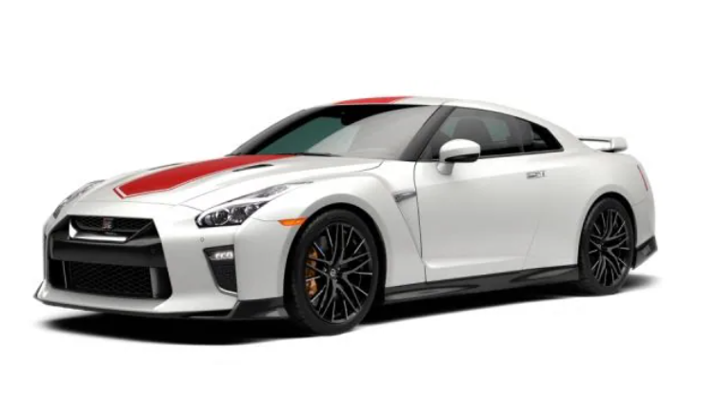
Nissan 2020
Electrification
2. Innovation
3. Performance
4. Partnership
5. Transformation

Slide 29
MARKETING STRATERGIES

Slide 30

Product Integration
Co-Promotions
Social Media
Events
Merchandising

Slide 31
future

Slide 32
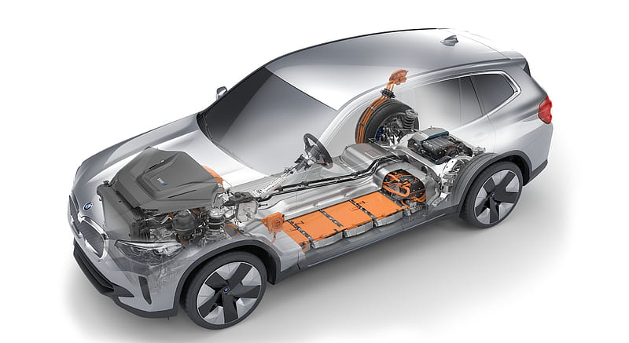
Electric Powertrain?
There's a strong possibility that the R36 will feature an electric powertrain, with Nissan's Formula E campaign serving as a testing ground for the technology ².
However, the company is waiting for advancements in battery tech, specifically solid-state batteries, before committing to an EV ¹ ². A hybrid powertrain is also being considered as a backup option ².

Slide 33
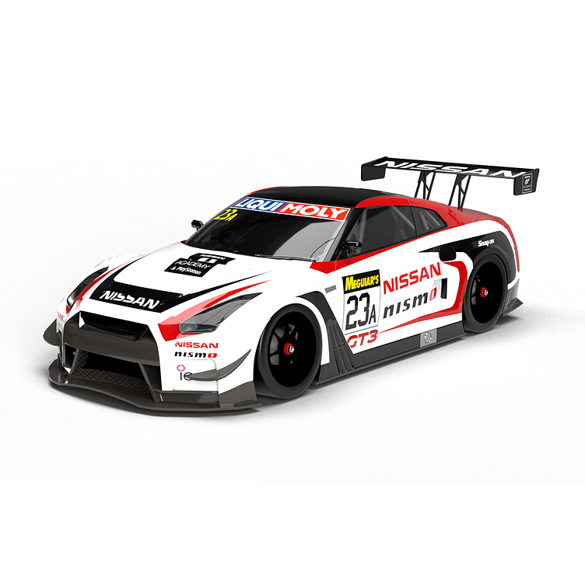
Design and Features
The R36's design is already underway,
with multiple concepts being reviewed ². The iconic quad-circle taillights will likely carry over, and the car's bullying, brutish style will endure ². T
he interior will feature advanced tech, including a potential partnership with Polyphony Digital, the developers of Gran Turismo ³.
Next-Gen ZNissan has also confirmed that the next-gen Z is in development, with a potential release in 2025 or later ². The new Z will likely feature a hybrid powertrain and a radical new design direction.

Slide 34
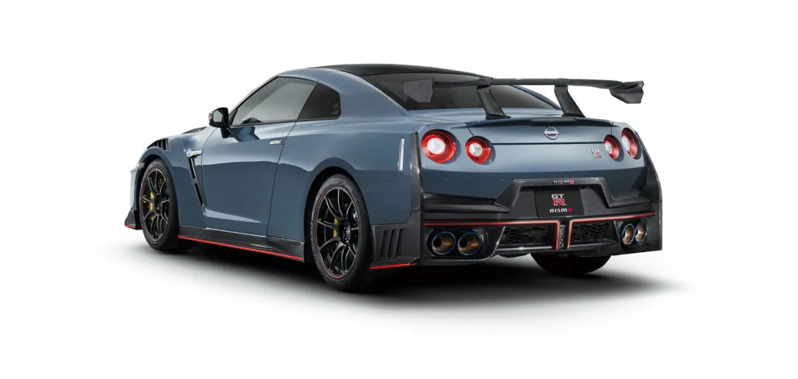
2025 Nissan GT-RIn
the meantime, the 2025 Nissan GT-R has been launched in Japan,
featuring updated models like the Premium Edition T-spec and the Track Edition engineered by NISMO ⁴. These models boast improved performance, aerodynamics, and styling

Slide 35
SWOT

Slide 36




~swot
THANK YOU

Slide 37
STRENGTHS
1. Iconic Brand: The GT-R is a legendary nameplate with a rich history.
2. Performance: Exceptional acceleration (0-60 mph in 2.9 sec) and handling.
3. Advanced Tech: Features like all-wheel drive, adaptive suspension, and traction control.
4. Exclusivity: Limited production numbers maintain exclusivity and allure.
5. Racing Heritage: Success in various motorsports, including Super GT and FIA GT.
6. Design: Aggressive, aerodynamic styling sets it apart.
7. Brand Loyalty: Strong following among enthusiasts.

Slide 38
WEAKNESS
1. Age: Current R35 model debuted in 2007; showing its age.
2. Weight: Heavy curb weight affects agility and fuel efficiency.
3. Interior Space: Limited rear seats and cargo area.
4. Infotainment: Outdated system compared to competitors.
5. Price: High starting price ($113,000+) limits accessibility.
6. Fuel Economy: Poor fuel efficiency (16 mpg combined).
7. Maintenance: High maintenance costs due to complex engine.

Slide 39
OPPORTUNITIES
1. Electrification: Potential hybrid or electric powertrain for improved efficiency.
2. New Markets: Expansion into emerging markets (e.g., China, India).
3. Refreshed Design: Update to modernize styling and interior.
4. Technology Integration: Advanced safety features and infotainment.
5. Performance Variants: Limited-edition models or special editions.
6. Partnerships: Collaborations with other brands or racing teams

Slide 40
THREATS
1. Competition: Rivals like Porsche 911, Chevrolet Corvette, and BMW M4.
2. Regulatory Changes: Emissions regulations may impact performance.
3. Market Shift: Declining demand for high-performance gas-powered cars.
4. Economic Uncertainty: Global economic fluctuations affect luxury car sales.
5. Brand Image: Perception of Nissan as a mainstream brand, not luxury.
6. Alternative Performance Options: Electric vehicles and hybrid sports cars.

Slide 41
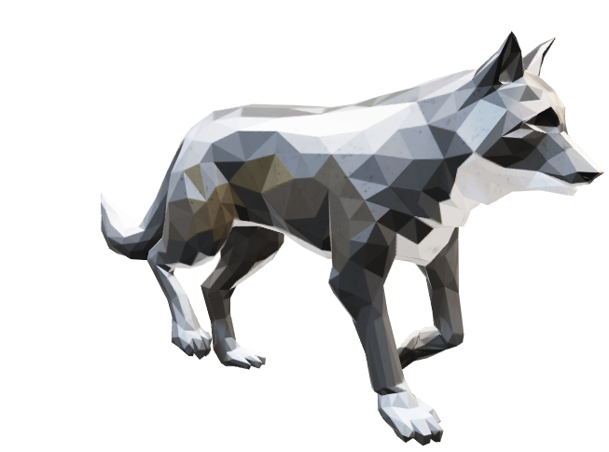

THANK YOU

